Slide 1
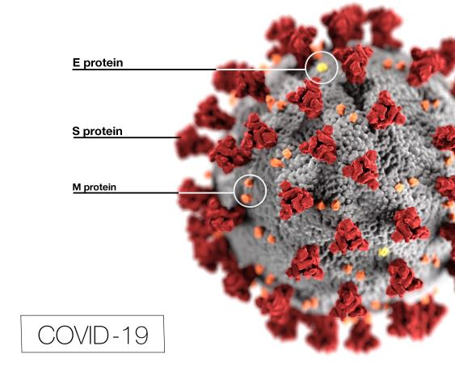



Welcome to week 7!
Chapter 21 and 22
Reminders:
Vaccine/Immune Assignment
The purpose of this assignment is to evaluate a variety of sources as they pertain to vaccines, immunity and COVID.

Slide 2

For fun: Thanks, ES!
What did the femur say to the patella?
I knee-d you!

Slide 3

Vessels and Resistance: THINK-What can slow down blood flow? (mathematic, or practical)
Note: Veins are called “capacitance” vessels. They have thinner walls, can stretch easily and therefore can hold a lot-capacity.
Increase Pressure Flow
Volume Increase Increase
Resistance/Viscosity Increase Decrease
Length Decrease Decrease
Diameter________Decrease_____________Increase
*remember that contraction decreases dia. & relaxation increases it.

Slide 4

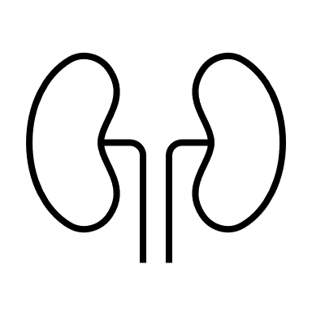
Analogy: imagine flow to an organ

Slide 5
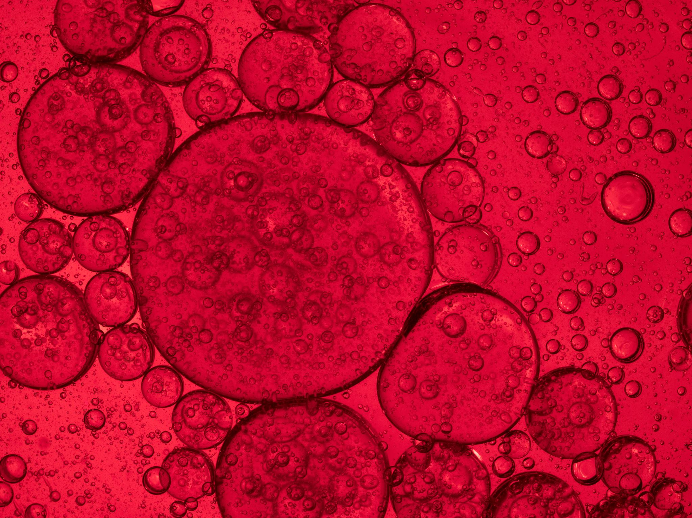
Let’s practice:
When length increases, flow ______________________
When viscosity decreases, P ____________and Flow___________
When diameter decreases (lumen, this is vasoconstriction),
P ____________________and flow__________________
When salt increases, volume_____________and P ___________

Slide 6
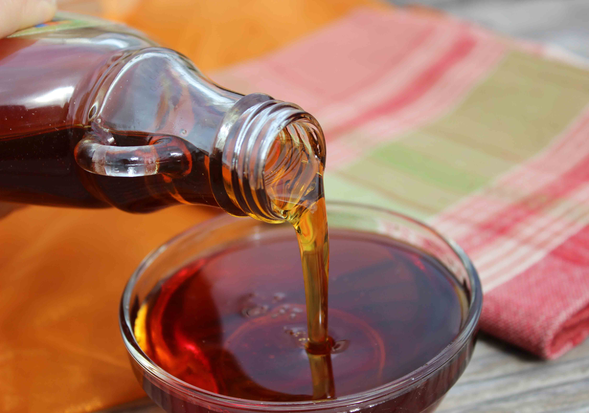
Let’s practice:
When length increases, flow decreases.
When viscosity decreases, P decreases and Flow increases
When diameter decreases (lumen, this is vasoconstriction), P increases and flow decreases
When salt increases, volume
increases and P increases

Slide 7
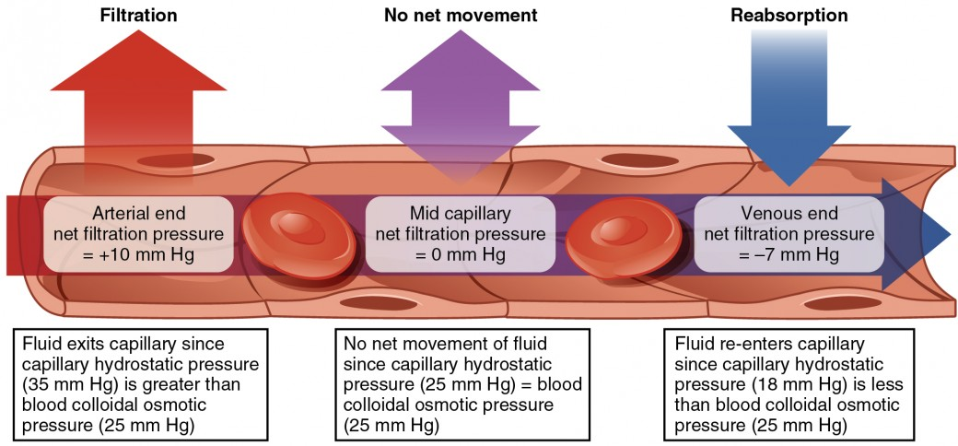
Lymph: stuff that oozes out to tissues and may or may not be returned to blood
Subclavian vein: allows lymph to enter bloodstream and head to hepatic portal vein
The liver stores phagocytes and filters antigens-particularly from gut.
The spleen also filters, and fights invading pathogens also storing WBCs.

Slide 8
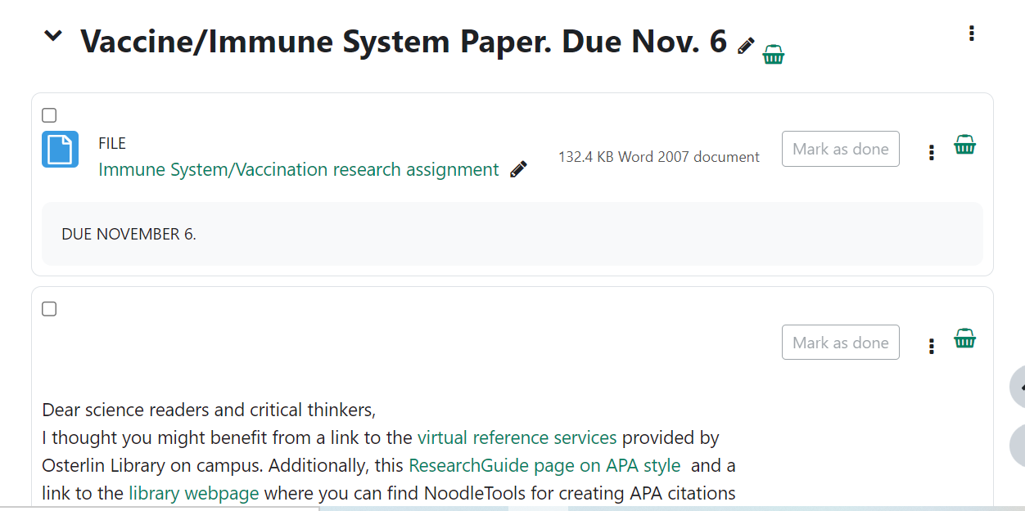
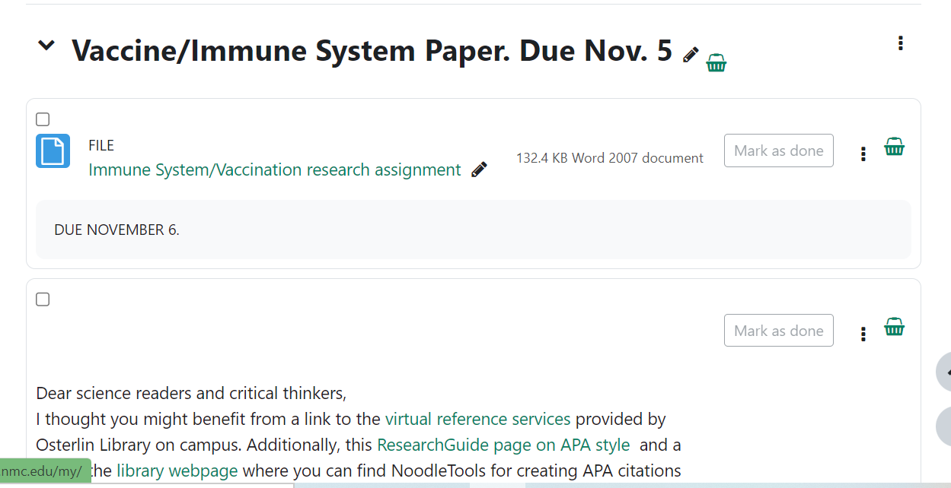
Immunity Science Summaries
ONLINE CLASS
HYBRID CLASS

Slide 9
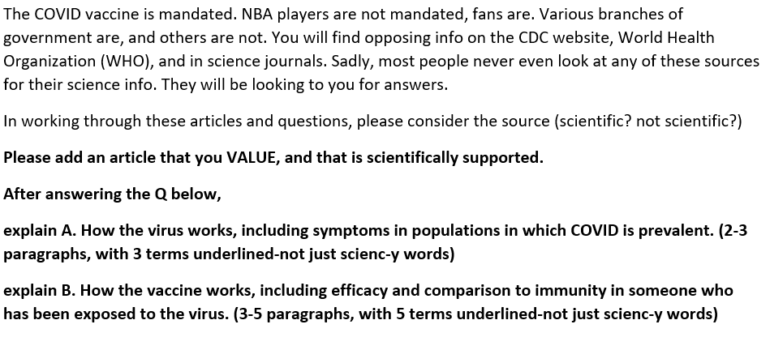
Paper: Seeking Science. When is it due?
Your task, in a nutshell is to:
1. Read articles I have provided and seek answers to the accompanying Q.
2. Explore the SCIENCE literature and find an article that sheds light for your patients AS WELL as your non-patients.
3. Explain
A (Virus including antibodies) and
B. (Vaccine)

Slide 10
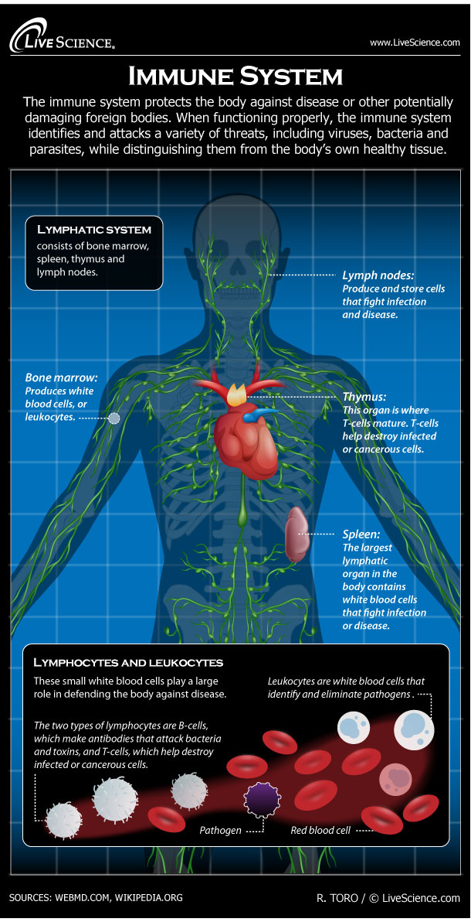
Lymphatic System: vessels and ducts that remove interstitial fluid from tissue and return it to the blood
(The other fluid in our body)
Key organs that produce WBCs;
Primary organs
Bones!
T cells mature in thymus (regulation)
B cells mature in bones (antibody-secreting)
Secondary organs
Lymph nodes
Spleen
What is the difference between lymphocytes and leukocytes?

Slide 11
Some immune terms
Basophil coordinate histamine and inflammation, large
Dendritic cell present antigens to the T cells
Mast cell heal wounds and defend
T cell (target in HIV) release cytokines
Memory Cell specific, form response and are REactivated
Epitope signal on cell. In HIV, CD4 is main signal
Neutrophil, monocyte, macrophages and mast cells are all phages
Cyto-vs. chemokine cyto is general, and chemo is specific cyto for inflammation. Proteins that trigger reception
T and B both start in bone and develop in Bone or Thymus

Slide 12
-cytes
Erythrocytes=RBCs, carry O via hemoglobin
Leukocytes=WBCs (granulocytes or agranulocytes)
Lymphocytes=agranular lymphocytes

Slide 13
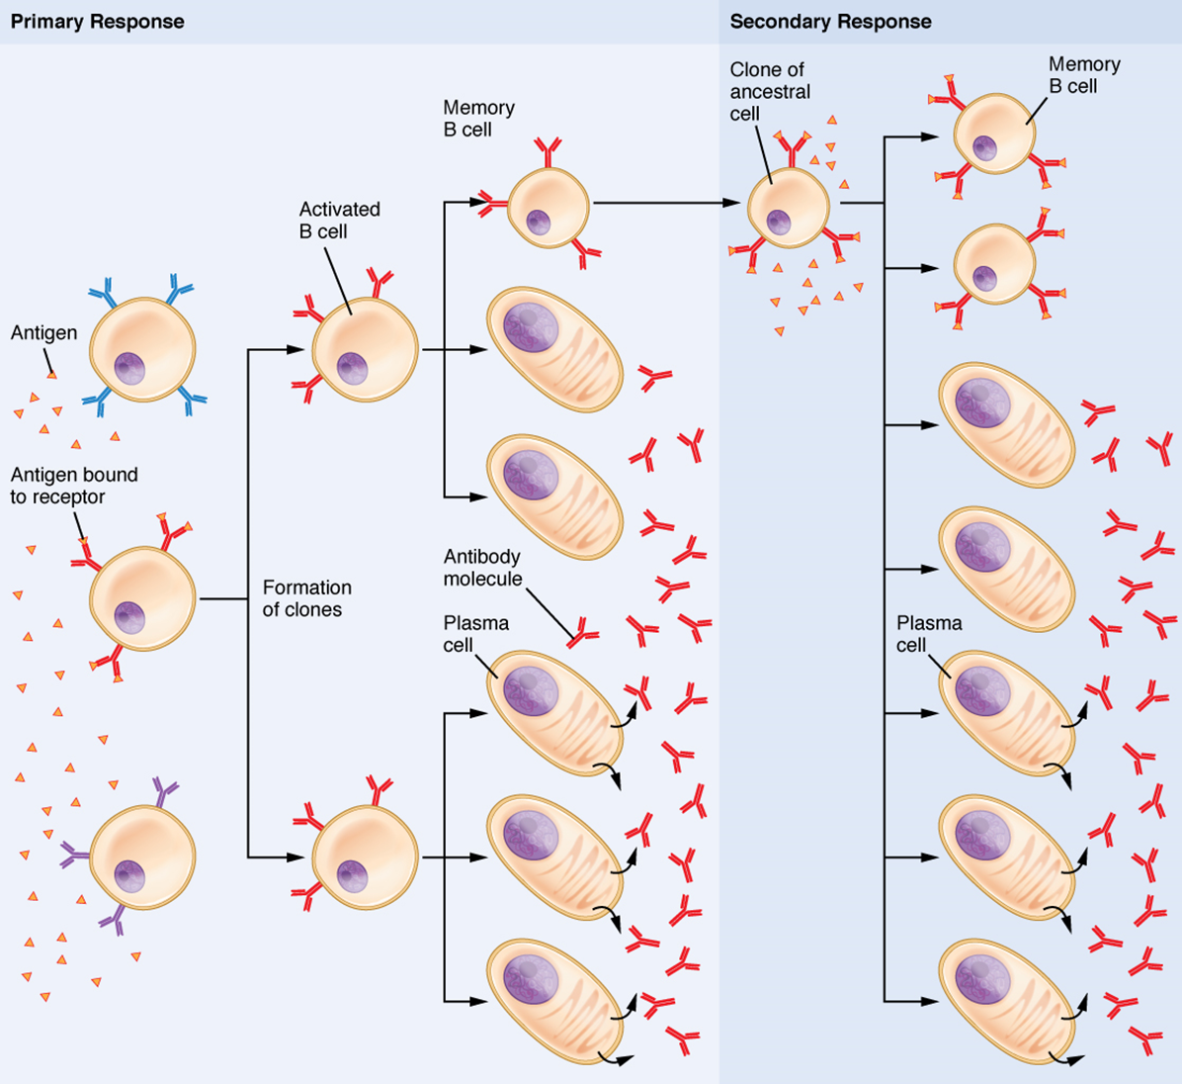
Cells
Found under Read/Watch
“Images for Immunity”

Slide 14
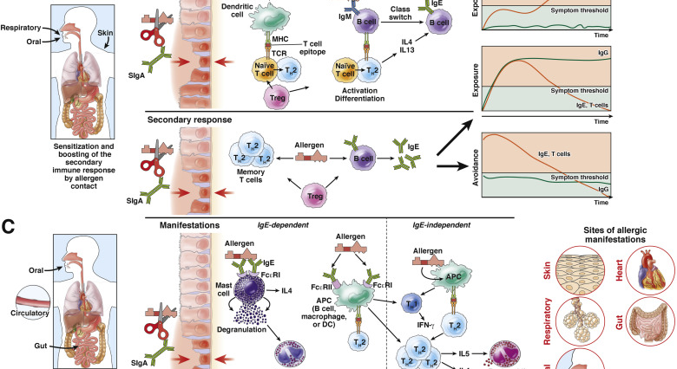

Slide 15
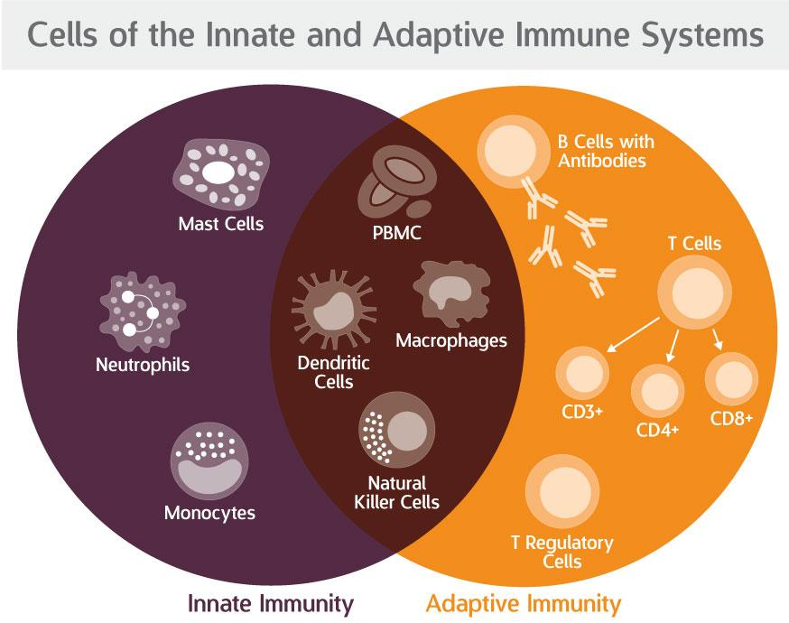
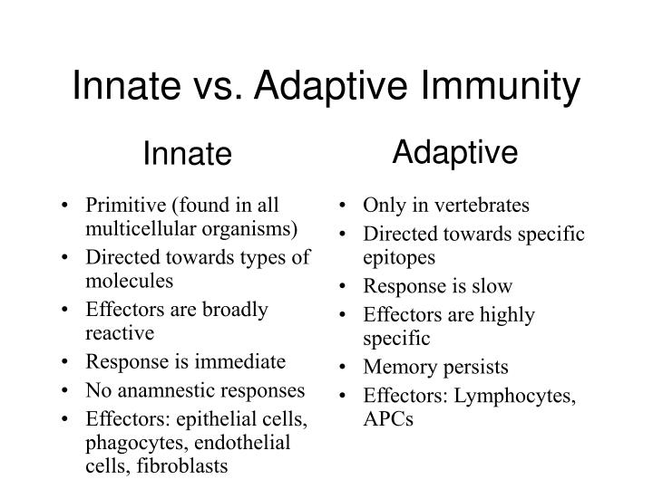
Immunity: this is what we want

Slide 16
Barrier Defenses and the Innate Immune Response Chronological=Barrier, Innate, Adaptive
1. Barrier defenses-body’s first line of physical defense against pathogens
2. Innate immune responses-early physiological control of infections. Innate responses occur rapidly, but with less specificity and effectiveness
Innate responses can be caused by a variety of cells, mediators, and antibacterial proteins such as complement.
3. Adaptive immune response.
Within the first few days of an infection, another series of antibacterial proteins are induced, each with activities against certain bacteria, including opsonization of certain species.
Additionally, interferons are induced that protect cells from viruses in their vicinity.

Slide 17
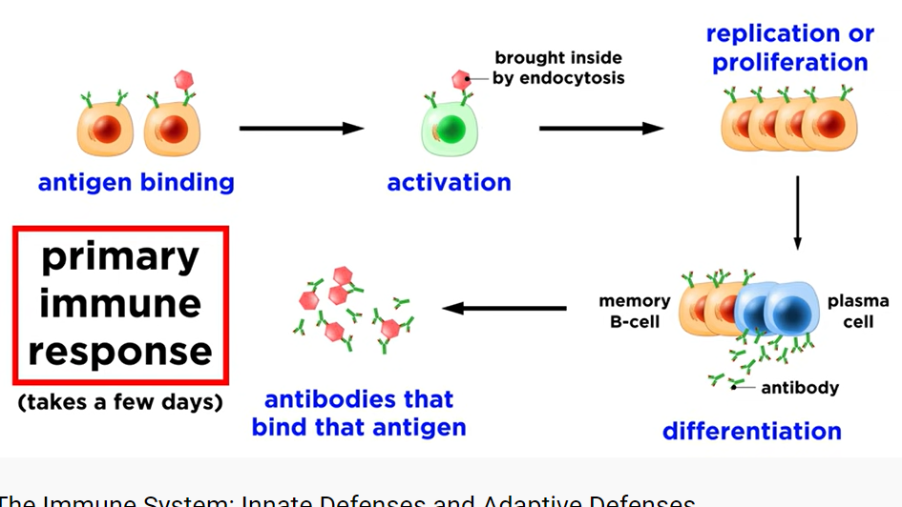
Primary and Humoral (think fluid)

Slide 18
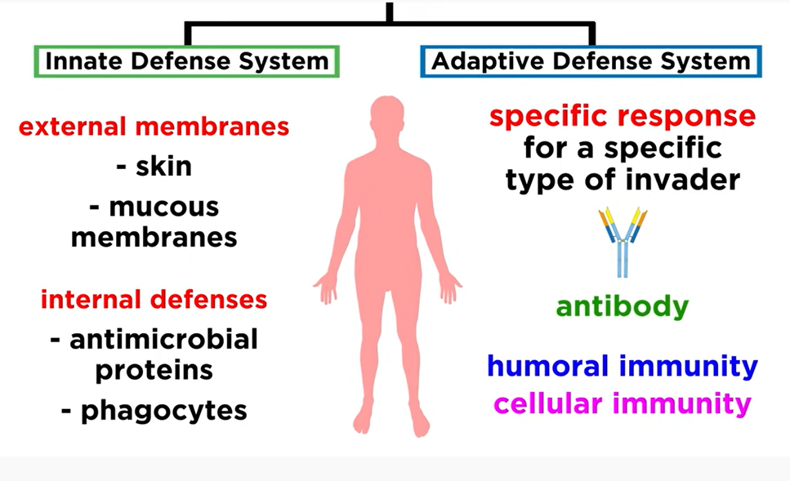
Innate vs. Adaptive (develops, think: specific memory)

Slide 19
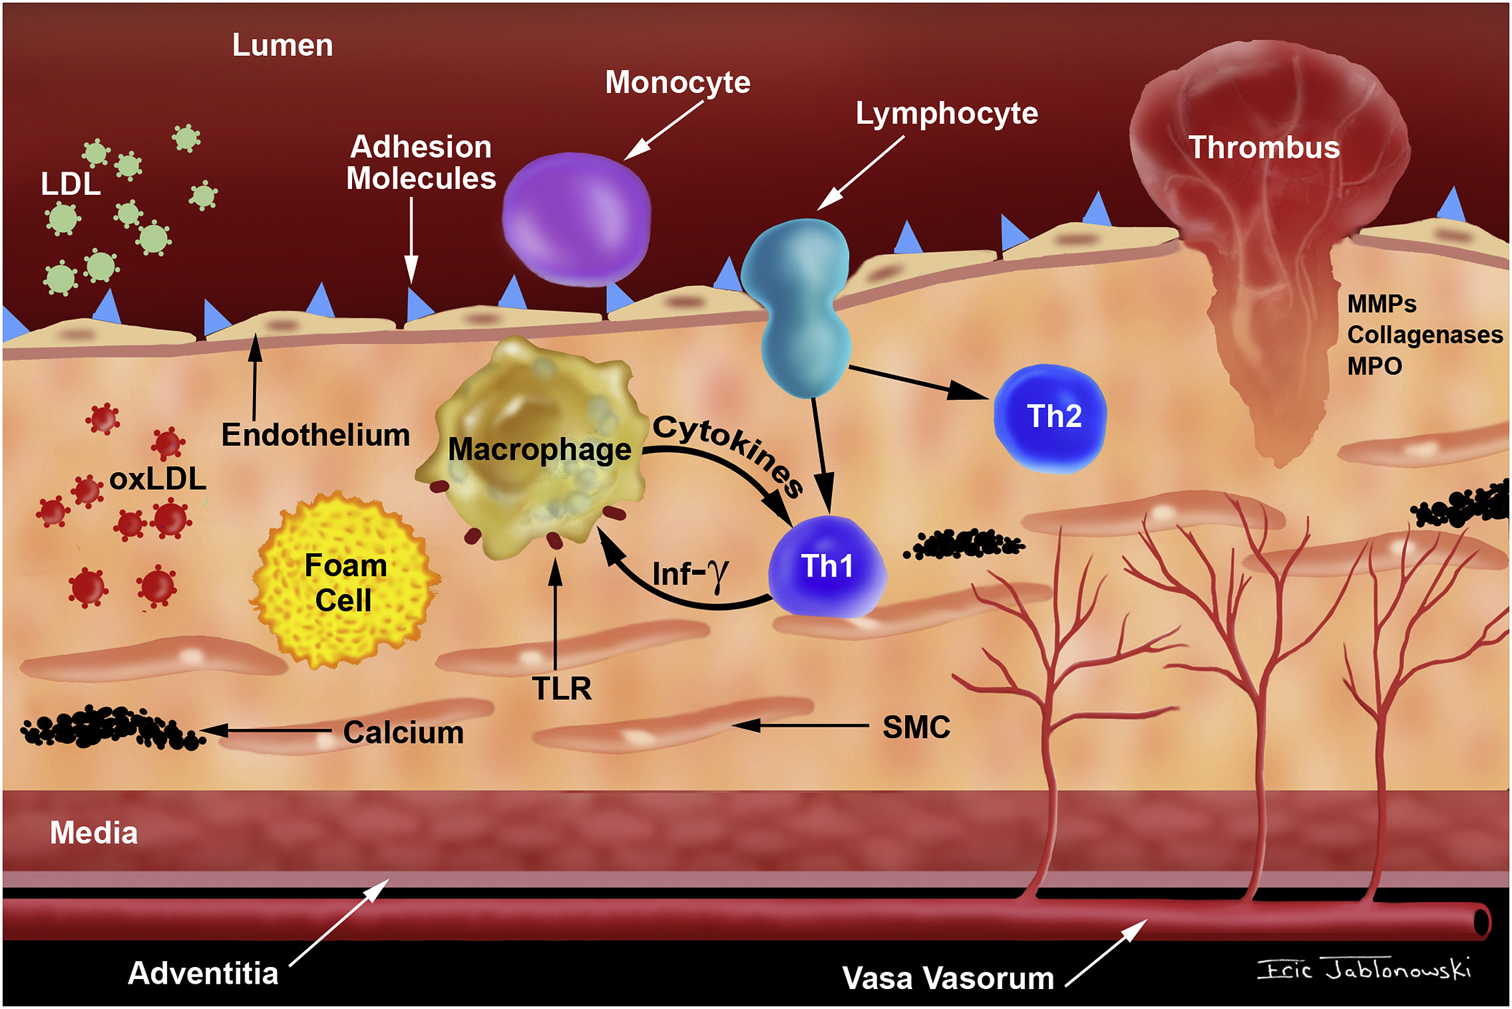
Ch 20: Trent: “Vasoconstriction”. WHY? 22 Recall “Inflammation” (endothelium is a straight-up liner)

Slide 20
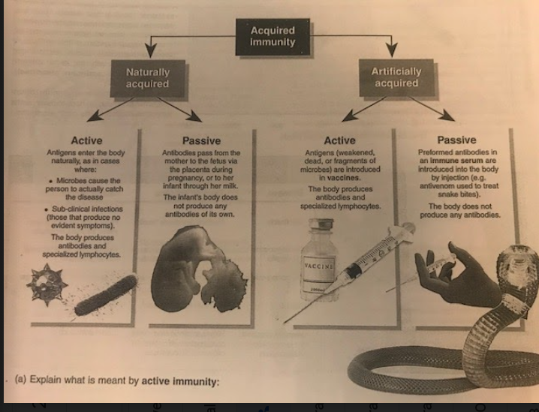
Immunity: this is how we Naturally have it….. or Achieve it

Slide 21
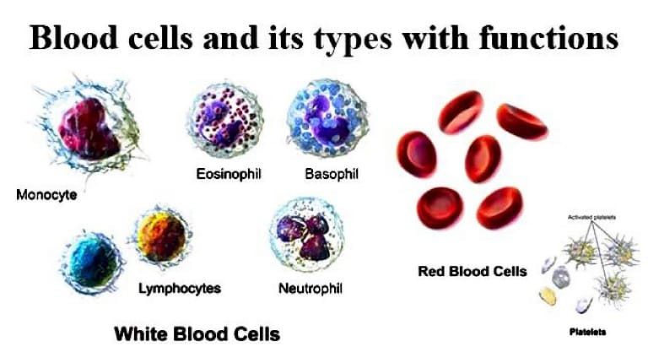

Slide 22
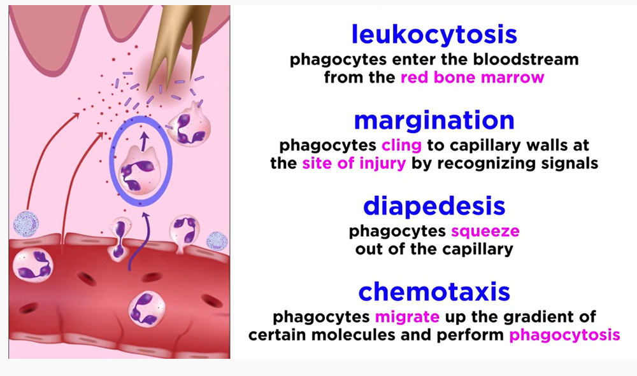
Phagocytes are Innate

Slide 23
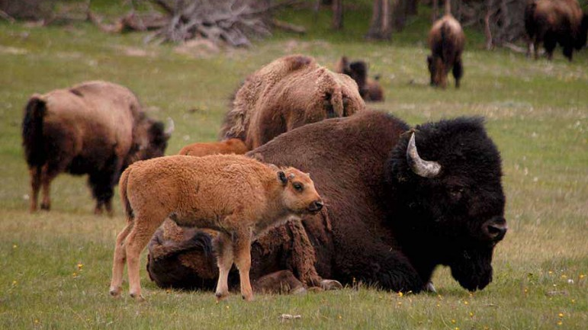
Herd Immunity, Ecology Version
The immunity an individual has due to exposure to multiple pathogens as a result of being part of a larger population or herd.
(what do you know about immunity as a result of COVID?)
Less immunity…..less resistance….our Immune systems are weaker, and more auto-immune diseases.
Resistance increases as exposure increases.

Slide 24
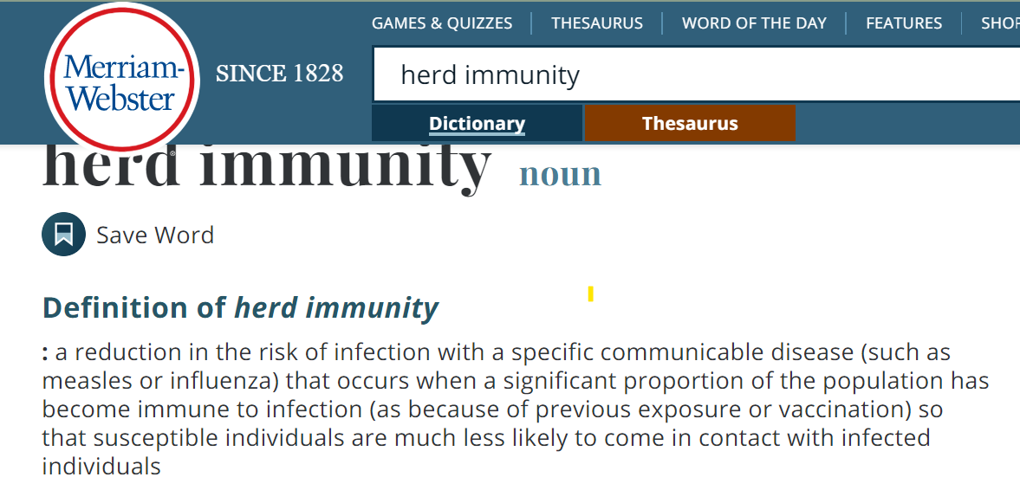
Herd Immunity: What is role of "contact"?

Slide 25
Pathogen specificity; starts developing in childhood
Mucosal barrier in intestine (IgA and IgM)
Bacteria and fungi controlled by complement proteins
Viruses controlled by interferons and cytotoxic t cells
Worms controlled by eosinophils

Slide 26
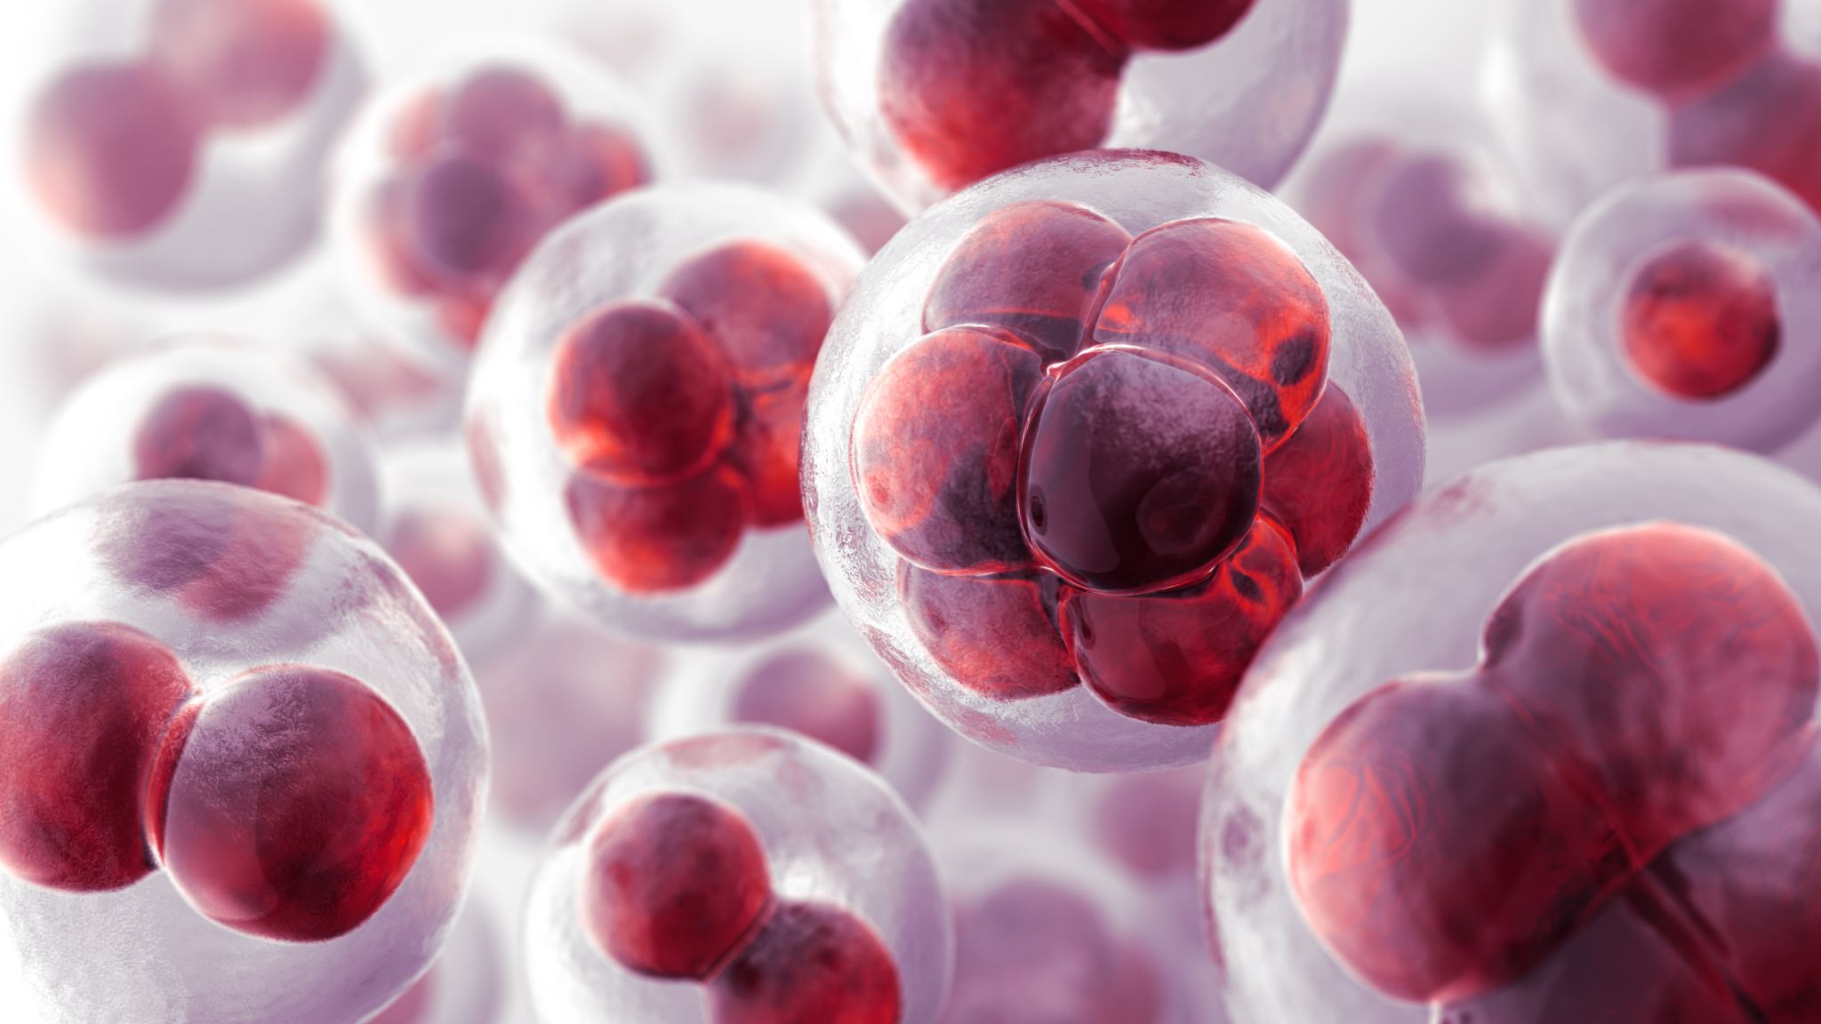
22.4, 22.9: Basically, the primary response is the first interaction with the antigen. Then clones of the T cells are made, allowing for memory.

Slide 27
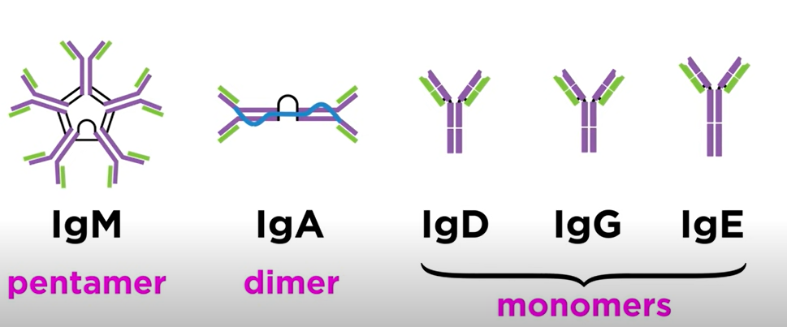
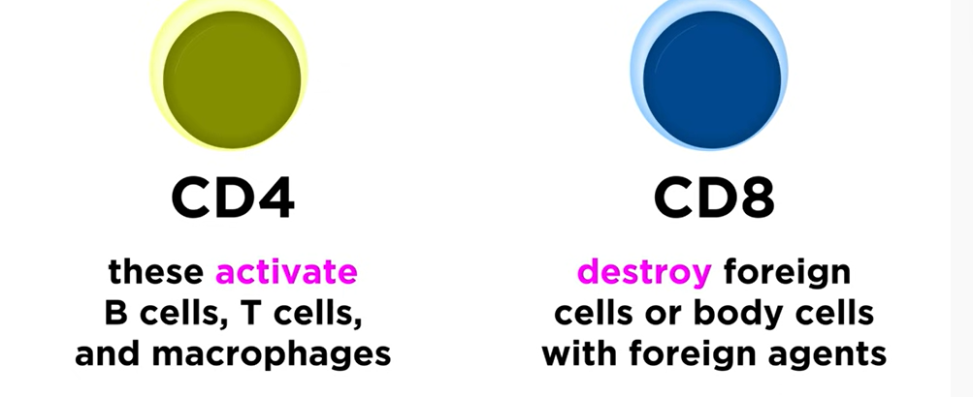
How do antibodies know?

Slide 28
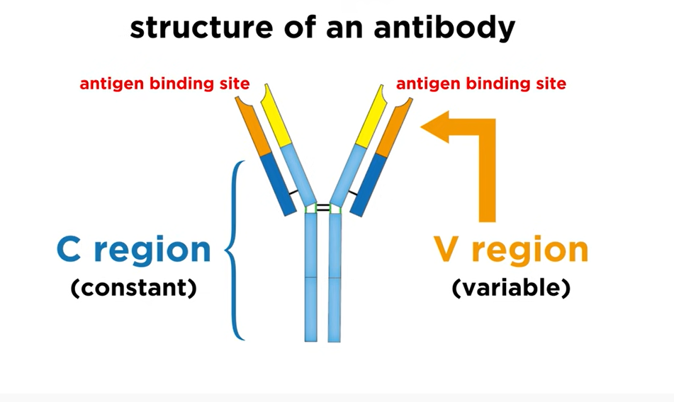
22.4
and
22.7

Slide 29
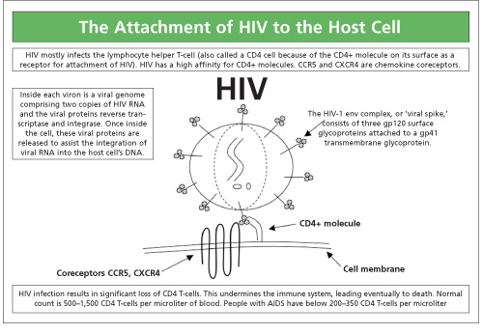
Adaptive Immune Response: T lymphocytes and Their Functional Types Review: Protein identifiers on the surface of the cell
T cells recognize antigens with their antigen receptor, a complex of two protein chains on their surface. They do not recognize self-antigens, however, but only processed antigen presented on their surfaces in a binding groove of a major histocompatibility complex molecule (MHC).
T cells develop in the thymus, where they learn to use self-MHC molecules to recognize only foreign antigens, thus making them tolerant to self-antigens. There are several functional types of T lymphocytes, the major ones being helper, regulatory, and cytotoxic T cells.

Slide 30
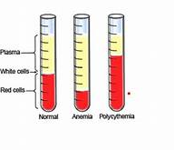
Review Blood cells are in three functional classes: red blood cells (erythrocytes), white blood cells (leukocytes) and platelets (thrombocytes). All three are formed in the bone marrow but have vastly different appearances and functions. Taken from “Resource: Blood Cell Types”

Slide 31
22.7 and Lab: Immune System using images
Antibody IgE=protein of immediate response
Antibody IgG=food sensitivity, can last longer (COVID)
Lymphocyte is a leukocyte but not all leukocytes are lymphocytes
Leukocytes:
Granular B. Agranular
neutrophil (destroy bacteria and fungi) monocyte (break down on entry)
basophil (alert-allergies) lymphocyte (produce antibodies)
eosinophil (parasites and cancer, allergies)

Slide 32
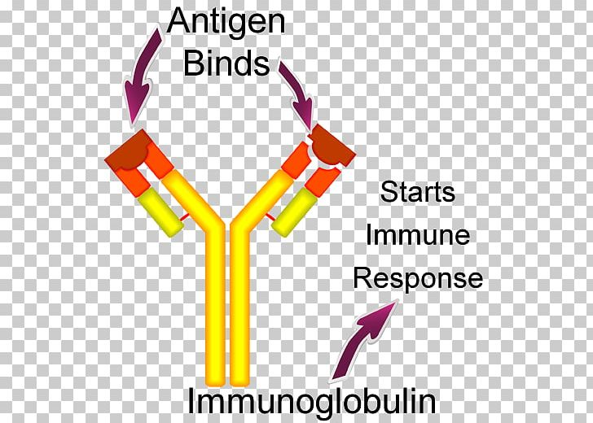
LAB: PhysioEx 12: Answer Questions for Act. 1, AND 3 ONLY the assumption is: If antigens generate antibodies, when we find a particular antibody, the antigen must be present also.

Slide 33
Some immune terms
Basophil coordinate histamine and inflammation, large
Dendritic cell present antigens to the T cells
Mast cell heal wounds and defend
T cell (target in HIV) release cytokines
Memory Cell specific, form response and are REactivated
Epitope signal on cell. In HIV, CD4 is main signal
Neutrophil, monocyte, macrophages and mast cells are all phages
Cyto-vs. chemokine cyto is general, and chemo is specific cyto for inflammation. Proteins that trigger reception
T and B both start in bone and develop in Bone or Thymus

Slide 35
The Adaptive Immune Response: B-lymphocytes and Antibodies
B cells, which develop within the bone marrow, are responsible for making five different classes of antibodies, each with its own functions. B cells have their own mechanisms for tolerance, but in peripheral tolerance, the B cells that leave the bone marrow remain inactive due to T cell tolerance. Some B cells do not need T cell cytokines to make antibody, and they bypass this need by the crosslinking of their surface immunoglobulin by repeated carbohydrate residues found in the cell walls of many bacterial species. Others require T cells to become activated.

Slide 36
Hypersensitivities: Autoimmune ("against self") component on bacterium cross reacts with self-antigen.
The immune response can be under-reactive or over-reactive. Suppressed immunity can result from inherited genetic defects or by acquiring viruses. Over-reactive immune responses include the hypersensitivities: B cell- and T cell-mediated immune responses designed to control pathogens, but that lead to symptoms or medical complications.

Slide 37
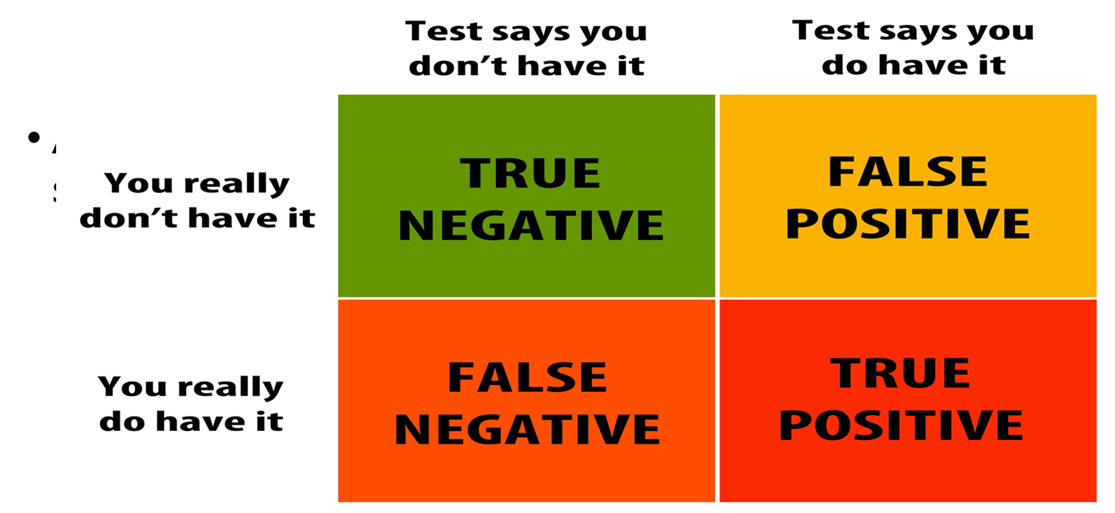
Study of “Serology” or Serum

Slide 38
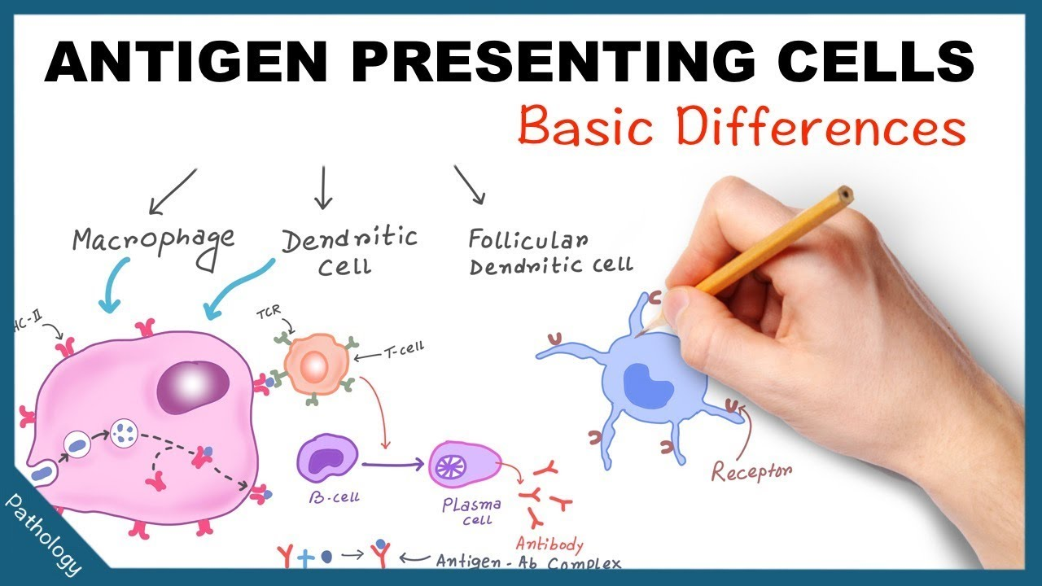
Immunity used to be grouped into “cell-mediated” (T and B) and humoral (fluid-antibodies)
There are “markers” (epitopes on antigens, where antibodies attach) on cells that mark them foreign or not-foreign (and remember viruses try to trick us) and MHCs (genes that code for particular cell-surface proteins)
Opsonization makes a foreign cell more susceptible to phagocytes.
Dendrites “present” antigens to T cells.
Naive T cells do not yet have “memory”

Slide 39
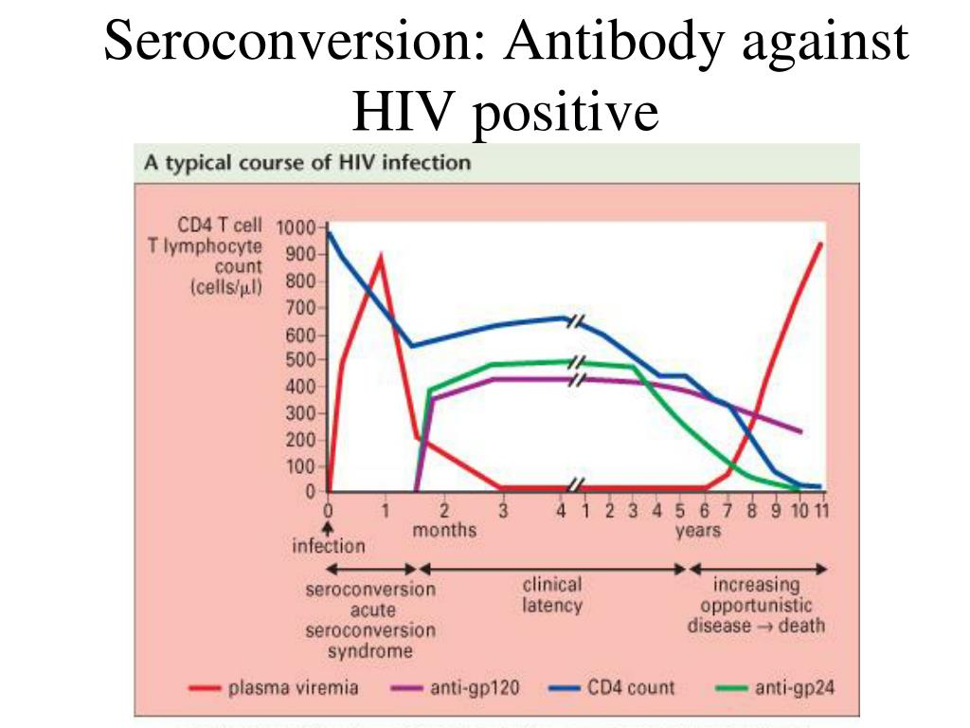
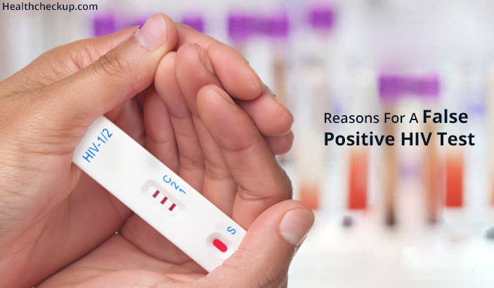
Seroconversion
Sero= to Sero +
False +

Slide 40
the assumption is: If antigens generate antibodi the assumption is: If antigens generate antibodies, when w the assumption is: If antigens generate antibodies, when we find a particular antibody, the antigen must be present also. e find a particular antibody, the antigen must be present also. es, when we find a particular antibody, the antigen must be present also.
“Immunosorbent” (antibodies absorbed due to insoluble and added antigens.)
Fluorescent Antibody Test
Fluorescent dye molecule attaches to antibodies and ac as a visible signal for the presence (+) of the antigen
Chlamydia is an “obligate” bacterium (killed by normal conc. Of O2)-it invades its host.
ELISA=enzyme-linked-immunosorbent assay
-detects antibodies the pt. has made against antigen
-result requires sero-conversion (-) to (+) or “time to detection”
-secondary antibody added to detect the first.

Slide 41
Western Blot test
-verifies ELISA false
-confirms HIV, lyme
-uses gel electrophoresis to separate proteins by size
-secondary antibody; enzyme attached (forms “complex” and allows for color to detect a protein)

Slide 42
Primary versus Secondary Response This is about speed and memory

Slide 43
Some Q to wrestle with: Substitute COVID with any viral disease….flu?
My patient is vaccinated and boosted. Can they still get COVID?
Is he or she more susceptible to COVID because a family member is not vaccinated?
Is there a relationship between exposure and duration or frequency of illness?
What happened to the Johnson and Johnson vaccine?
As a member of the health care system, are you more or less likely to get sick? Why or why not?
and is your friend who is active and involved, but does not interact with others as much as you more or less likely to get sick? (Why or why not?)

Slide 44
“Washing” and false-positives
“Washing” can eliminate unexpected proteins and non-specific binding.
Positive (+) controls give a standard for comparison
Negative (-) give a standard to which you would not expect a rxn.
A positive result with a negative control is “false-positive” and vice versa is a “false-negative”. These are both invalid results.

